Slide 1
IT Salary Survey
Presented by
Ha Phuong Thao

Slide 2
Table of Contents
1
2
3
4
Introduction
Data Cleaning
EDA
Model
5
Conclusions

Slide 3
01
Introduction
Dataset overview
Goal

Slide 4
GOAL
01
02
Determine which skillset needed for IT specialists
Determine features having effect on compensation paid to employees in IT industry
03
04
Help employees determine their pay range for themselves when dealing with company recruiters
Effected by Covid-19 Pandemic?
Notes:
analyze the wage levels and trends of various organizations to set up a fair and competitive compensation strategy for your own.

Slide 5

Dataset overview
Data source
Dataset was published on Kaggle as comma separated values (CSV) files
Survey in 2020
1253 respondents volunteered to participate in the survey in 2020
23 columns
Europe
Background information
Company information
Technologies at work
Salary in 2020 with and without bonuses and stocks

Slide 6
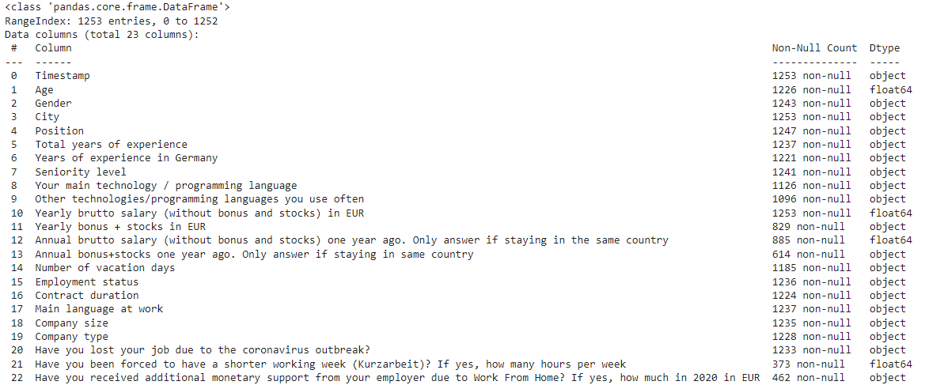
Data information

Slide 7
Features
02
01
Number of vacation days
Numerical
Years of experience in Germany
Age
Gender
City
Total years of experience
Position
Timestamp
Have you been forced to have a shorter working week (Kurzarbeit)? If yes, how many hours per week
Categorical
Yearly brutto salary (without bonus and stocks) in EUR
Seniority level
Main language at work
Your main technology programming
Company size
Yearly bonus + stocks in EUR
Company type
Have you received additional monetary support from your employer due to Work From Home? If yes, how much in 2020 in EUR
Other technologies/programming languages you use often
Annual bonus+stocks one year ago
Employment status
Have you lost your job due to the coronavirus outbreak?
Annual brutto salary (without bonus and stocks) one year ago
Contract duration

Slide 8
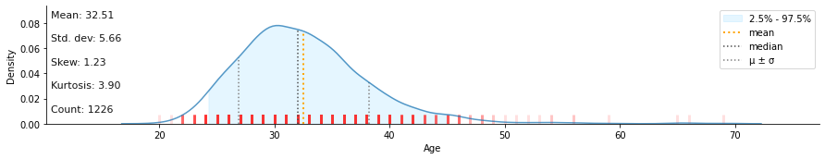
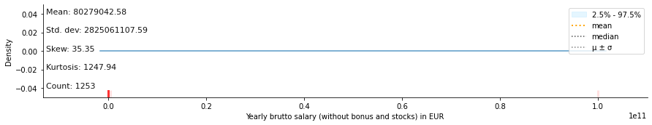
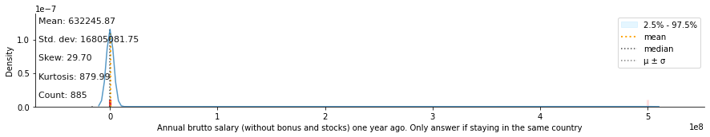
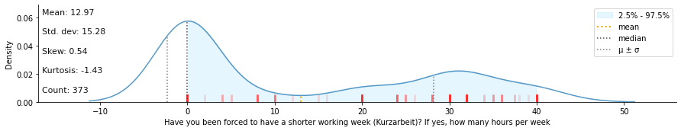
Distribution

Slide 9
02
Data Cleaning
Remove outliers
Replace null values

Slide 10
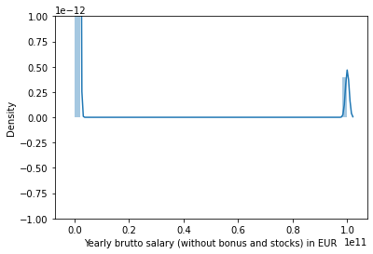
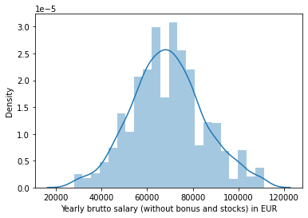
Yearly brutto salary (without bonus and stocks) in EUR
Before
After
Removing outliers using IQR quantile

Slide 11

BACKGROUND INFORMATION
Replace null values with mode value
Age
Replace null values with “Not_specified”
Replace somewords
Position
Replace null values with “Not_specified”
Gender
Total years of experience
Replace null values with mode value
Replace some string to number
Change type of column
Replace null values with mode value
Main language at work
Years of experience in Germany
Your main technology programming
Seniority level
Replace null values with “Not_specified”
Replace somewords
Other technologies/programming languages you use often
Replace null values with mode value

Slide 12

Company
Replace null values with mode value
Group data
Company Type
Employment status
Replace null values with mode value
Replace null values with mode value
Contract Duration
Replace null values with mode value
Company size
City
No null value

Slide 13
Effected by COVID-19 Pandemic?
'Have you lost your job due to the coronavirus outbreak?'
Change other answers in one group “Others”
Replace missing values with “Others”
'Have you been forced to have a shorter working week (Kurzarbeit)? If yes, how many hours per week'
Do not replace null values
'Have you received additional monetary support from your employer due to Work From Home? If yes, how much in 2020 in EUR'
Do not change null values

Slide 14
03
EDA
Analysis features in dataset
Hypothesis Testing

Slide 15
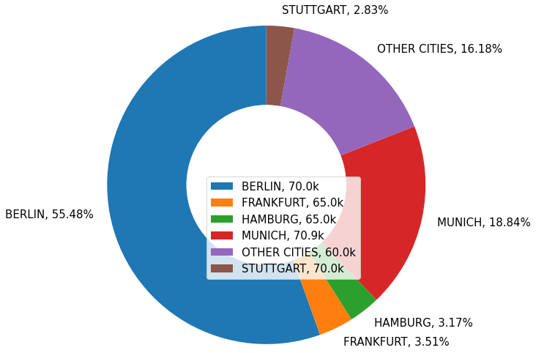
City
Almost respondents are from 45 German cities
Berlin
Munich
Frankfurt
1253
respondents

Slide 16
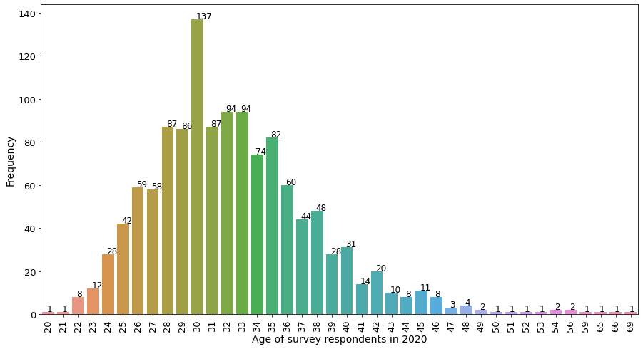
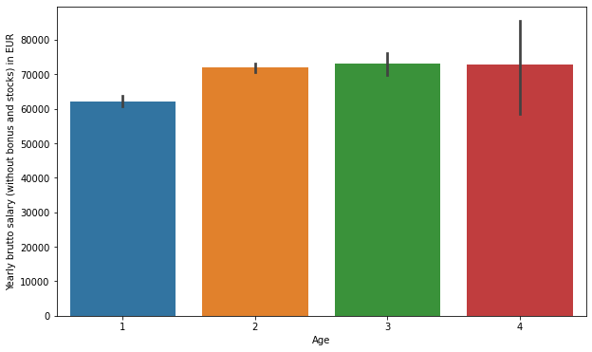
Age
59% are between 28-35 years of age
Group | Median Salary
Up to 30 | 62500
From 30 to 40 | 70000
From 40 to 45 | 75000
More than 50 | 70000

Slide 17

Gender
Female
15.67%
60k
Male
83.65%
Percentage of pay gap in this survey is 16.7%
70k
Global gender pay gap is around 16%

Slide 18
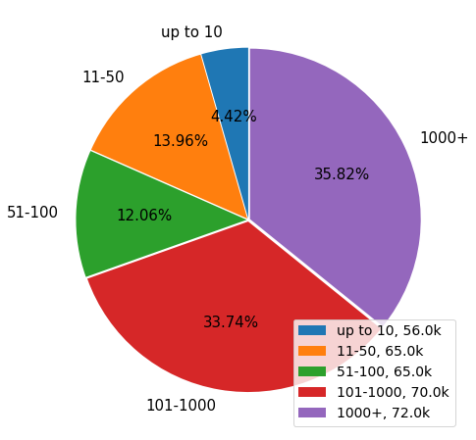
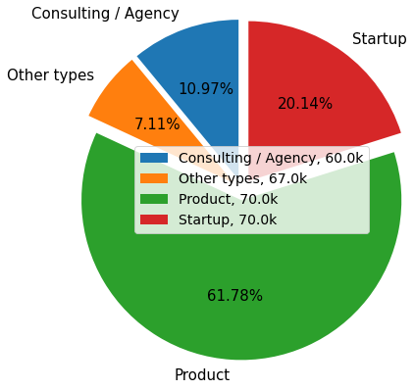
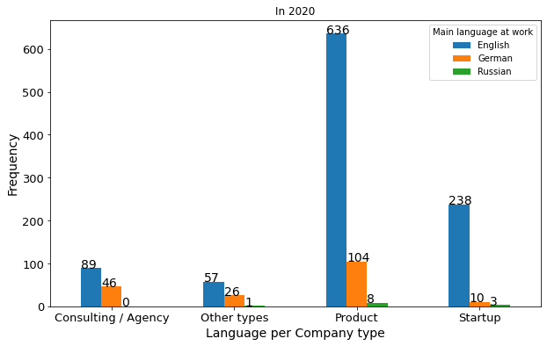
Company Size
Company Type
81% choose ENGLISH as main language at work and only 15% for German.

Slide 19
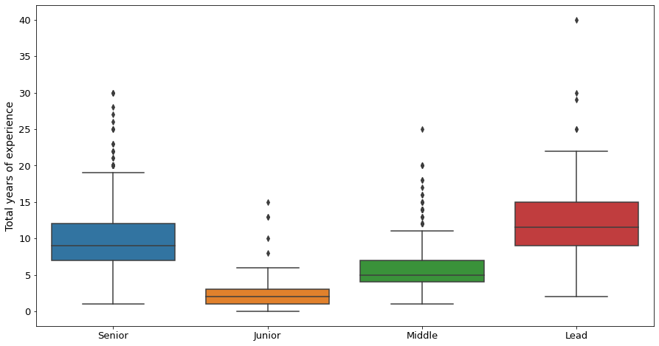
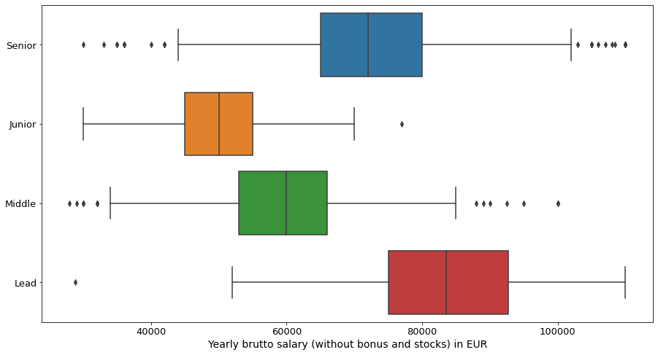
AVERAGE YEARS’ EXPERIENCE
81%
Have over 5 years of experience
29%
Have over 5 years of experience working in Germany
Among respondents there is
45% Senior, 27% Middle, 12% Lead, 6% Junior, and 10% other seniority levels.
Seniority level | Median Salary w/o bonuses and stocks | Median Salary w/ bonuses and stocks
Junior | 50000 | 52750
Middle | 60000 | 63000
Senior | 72000 | 75000
Lead | 83500 | 90000

Slide 20
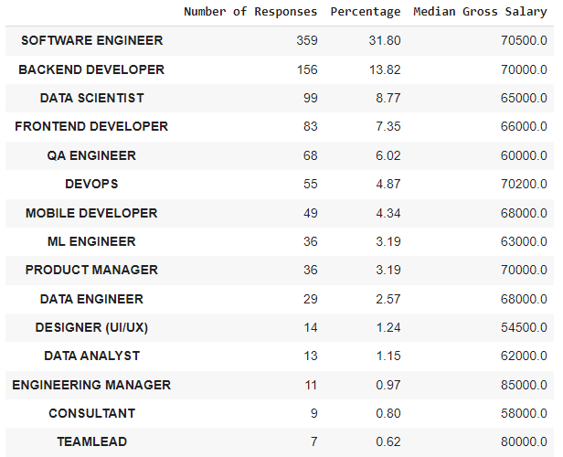
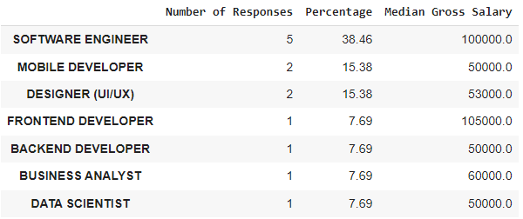
Full-time
Freelancer

Slide 21
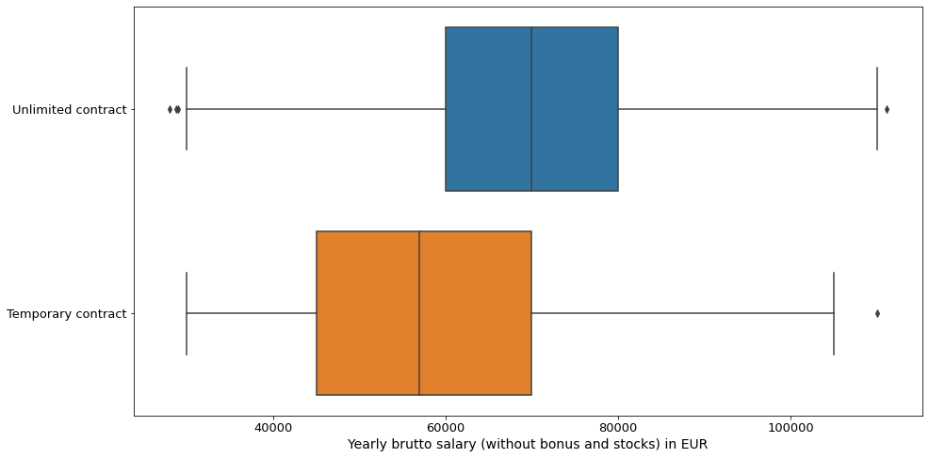
Contract Duration
Around 96% Unlimited Contract respondents
have median salary 70k, while median salary for 4% Temporary contract respondents is 57k

Slide 22
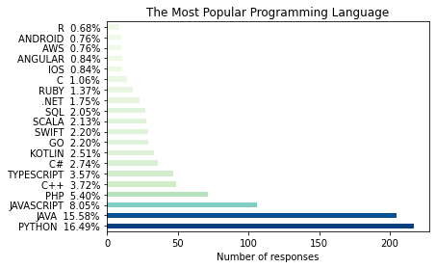
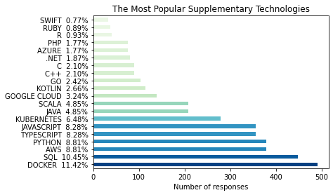
TECHNOLOGY
Python
Java
JavaScript
Docker
SQL
AWS

Slide 23
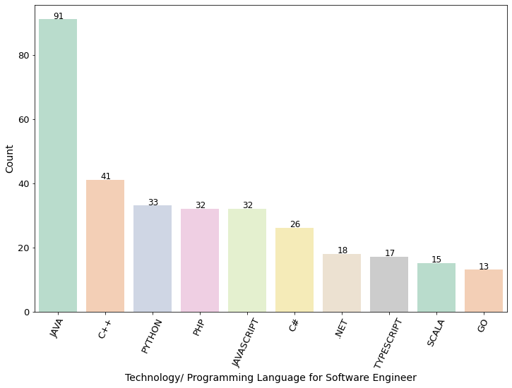
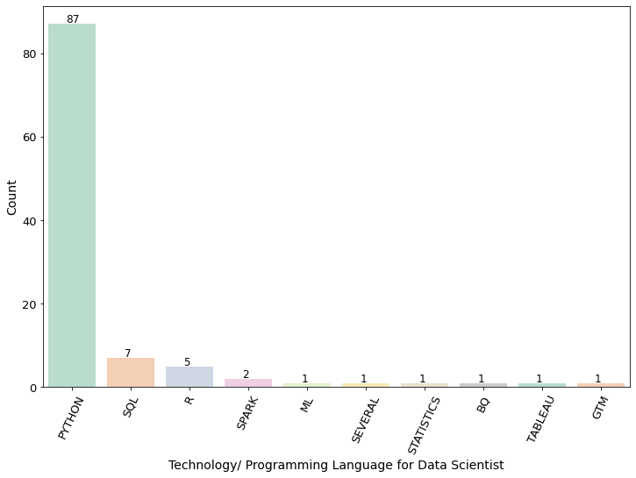
TECHNOLOGY
Java
C++
Python
Python
SQL
R

Slide 24
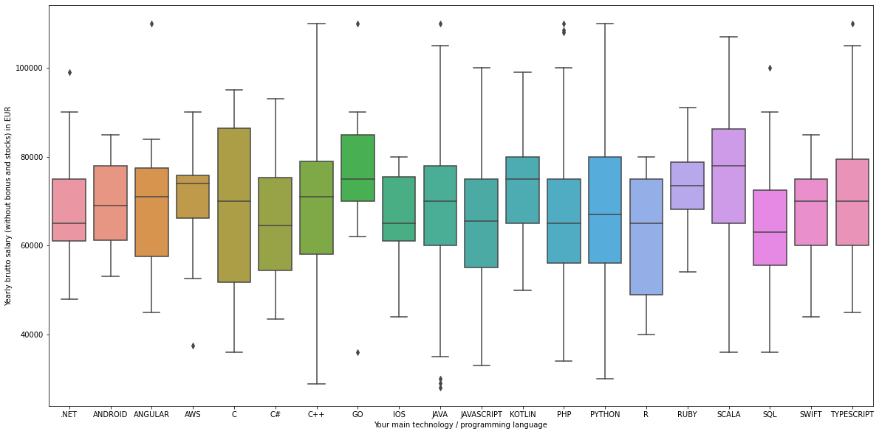
Salary vs Main Programming Language

Slide 25
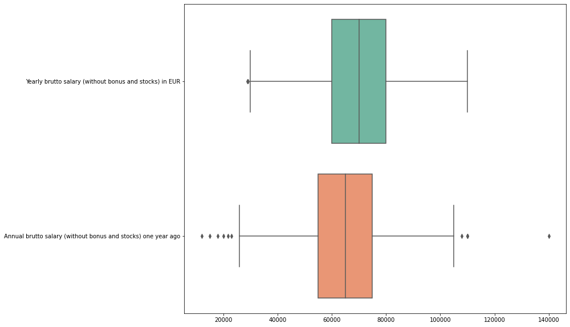
Salary without bonuses and stocks
2020
2019
Median annual salary has increased by 5k since last year and amounted to 70k.

Slide 26
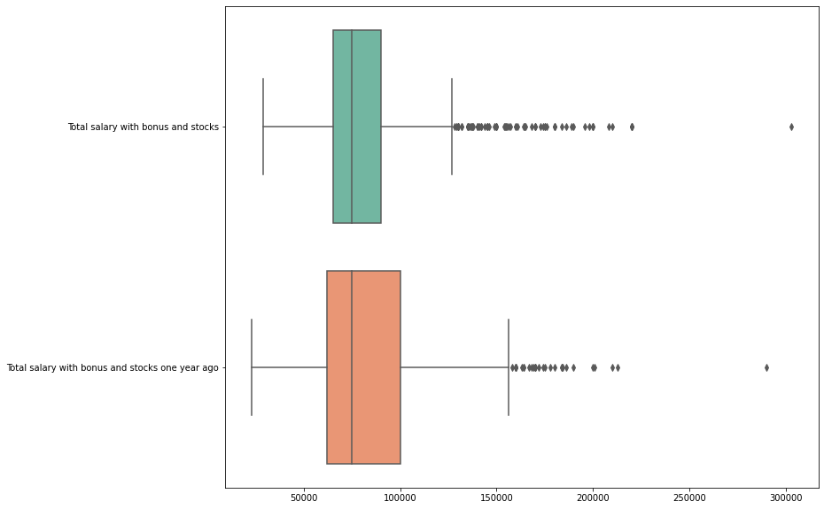
Salary with bonuses and stocks
2020
2019
Median in annual salary with bonuses and stocks is the same about 75k in 2019 and 2020.

Slide 27
Effected by Covid-19 Pandemic
Losing a job due to COVID-19?
“In April 2020, the unemployment rate in Germany rose to 5.8%.”
In our analysis, 4.4% respondents lost their job due to covid-19. Specifically, around 6.6% female lost IT jobs and 4% for male.
Having shorter working week?
In accordance with survey, around 30% of respondents have to reduced hours working week during the pandemic at the request of the employer. For half of them, this meant 0 working hours per week. Another half had from 8 to 30 working hours per week.
Monetary Support from Employer during COVID-19?
21% of respondents have received Corona-related financial support from their employers. A large percentage of them receive 500 euros support. Some cases are from 2000 – 5000 euros. The maximum support recorded in the survey ran up to 10 000 euros.

Slide 28
04
Model
Supervised Learning
Features selection
Linear Regression model
Result

Slide 29
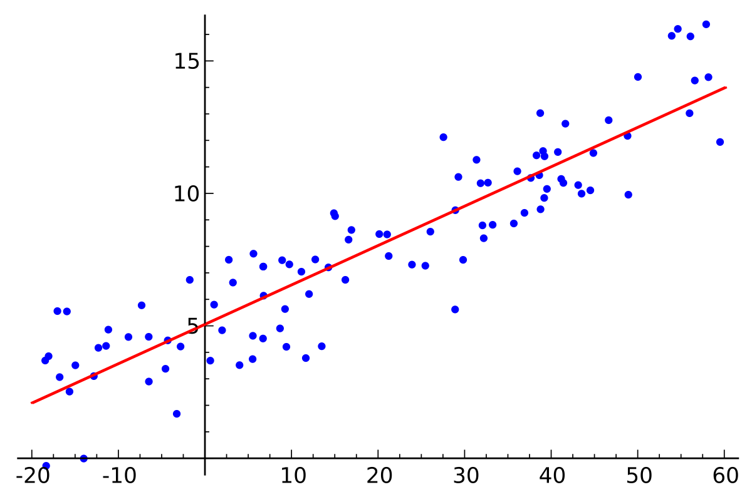
Supervised Learning
Label : Salary
Features: Other chosen factors in dataset

Slide 30
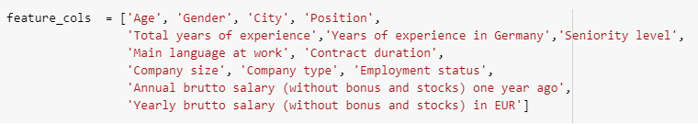
Selected Features

Slide 31
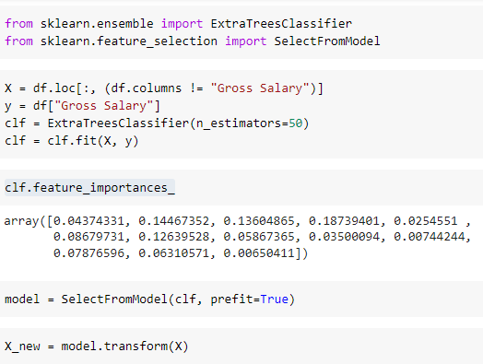
Features Selection

Slide 32
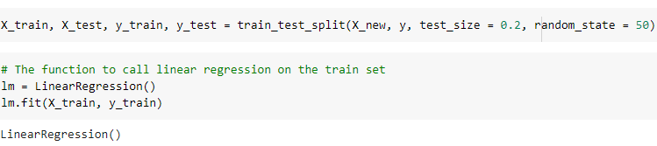
Linear Regression model

Slide 33
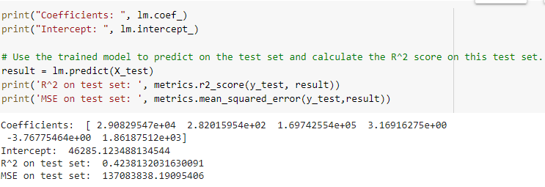
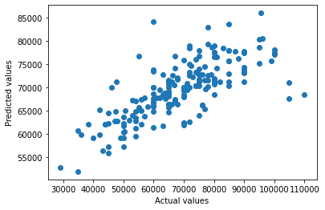
Result

Slide 34
05
Conclusions

Slide 35
01
02
03
Determine range of salary based on many factors of employees and companies
Main programming language and supplementary technology we need to know for each type of position
IT industry is not effected by Covid-19 Pandemic so much like other industries.
04
Improve linear regression model in the future

Slide 36
Thank you for listening

